Slide 1
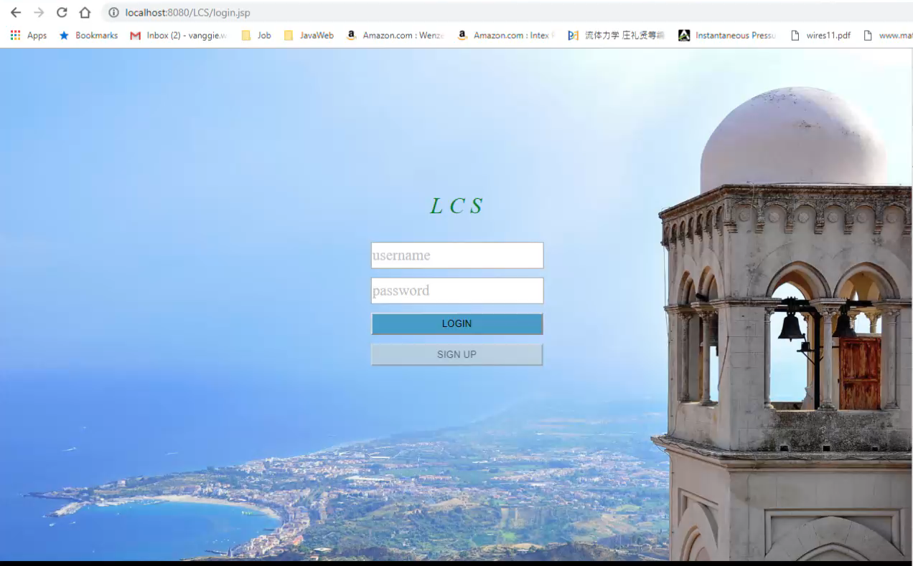
Online Access of the Code (ongoing)
Download the Omni3D code with provided username and password

